Slide 1

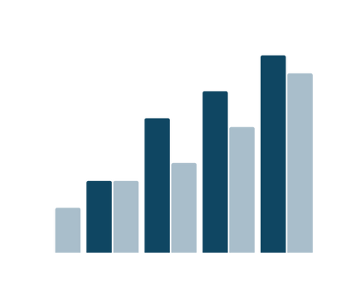
Data Engineering Project
Automated ETL with Data Lake Storage

Slide 2
Project Overview:
This project focuses on building an automated ETL pipeline using Azure services to streamline data ingestion, transformation, and deployment.
Azure Data Factory orchestrates the ETL workflow, ingesting data from multiple sources into Azure Data Lake Storage for centralized storage. Azure Databricks, powered by Spark, performs scalable and efficient data transformations.
Azure DevOps ensures automated deployment of ETL scripts and version control for continuous integration. The solution enables the processed data to be utilized for analytics, reporting, or machine learning, showcasing Azure's end-to-end capabilities.
This project demonstrates the integration of Azure tools to create a scalable, reliable, and efficient data processing pipeline for modern data-driven needs.

Slide 3
Tools Used:
Azure Data Lake Gen 2 Storage
Azure Databricks
Azure Data Factory
Azure DevOps
Project Requirement:
Data Ingestion Requirements
Data cleaning and Transformation Requirements
Data Analysis Requirements
Pipeline Requirements
Scheduling Requirements
Other Non-Functional Requirements

Slide 4
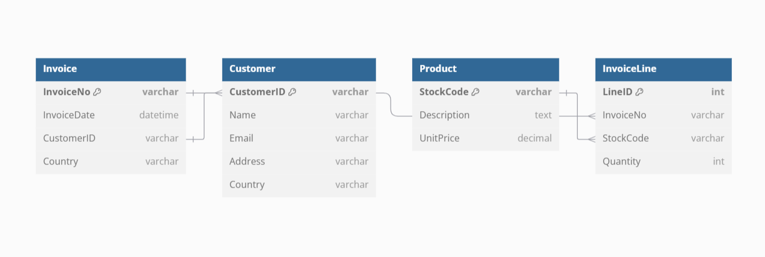
Design (ER Diagram):
Data Overview: The Online Retail dataset contains transactional data from a UK-based e-commerce store spanning the years 2009 to 2011. (From Kaggle)

Slide 5
Overall Workflow:
Azure Data Factory (ADF) orchestrates the execution and monitoring of Azure Databricks notebooks, enabling seamless CI/CD integration through Azure DevOps. The data pipeline starts by importing datasets from Kaggle into Azure Data Lake Storage Gen2 (ADLS), where raw data is stored in the Bronze zone (landing zone).
In the Bronze zone, data is ingested and validated before being processed using Azure Databricks notebooks. The first notebook performs data cleaning and merges the raw data into a unified table. The output is then stored in Delta tables within the Silver zone (standardization zone).
Subsequently, Silver zone data undergoes advanced transformation and enrichment using PySpark and Spark SQL in a second notebook. This step includes joining datasets, aggregating metrics, and applying business logic. The resulting structured and analysis-ready data is stored in the Gold zone (analytical zone) for downstream consumption. Azure DevOps facilitates CI/CD pipelines for deploying and maintaining these ETL scripts, ensuring efficient updates and version control for the ETL process.

Slide 6
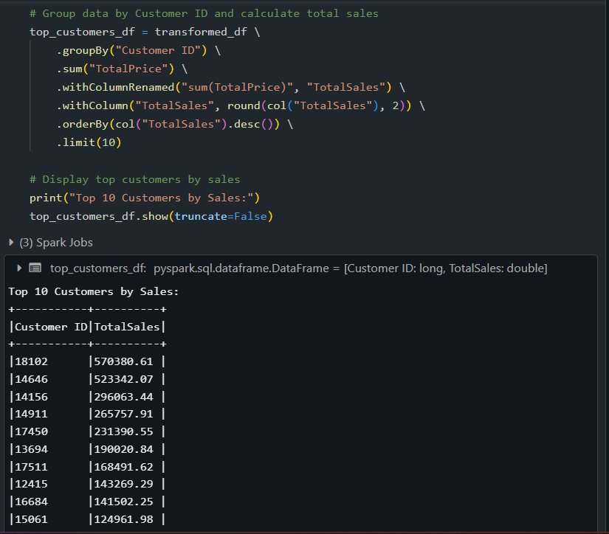
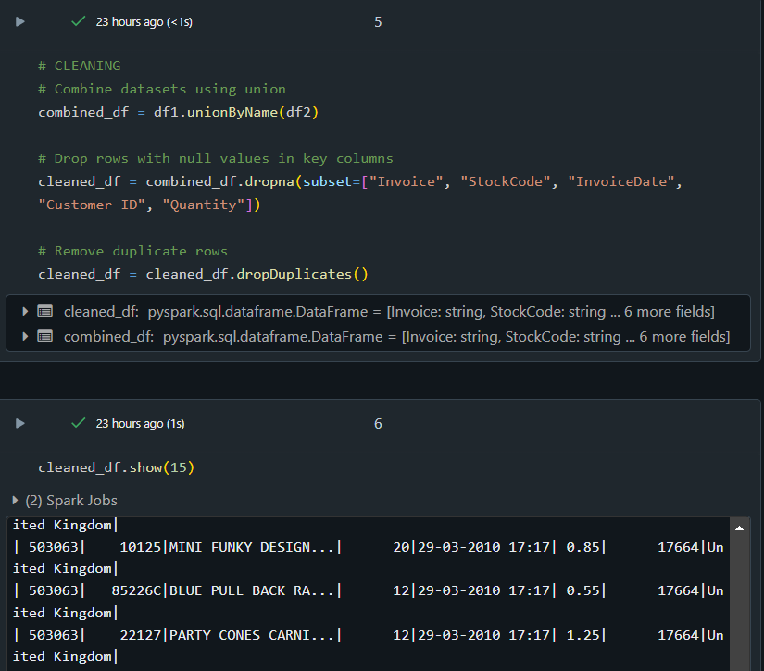
Demo: Sample ETL codes in Databricks

Slide 7
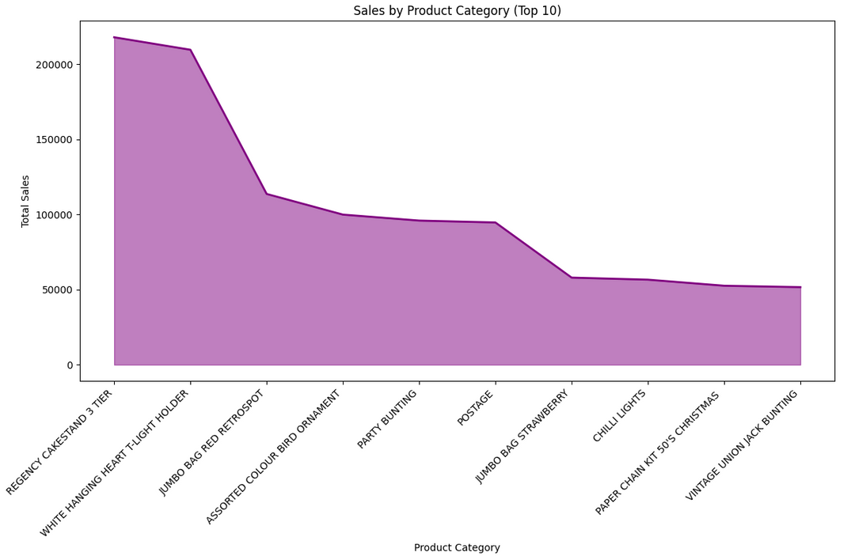
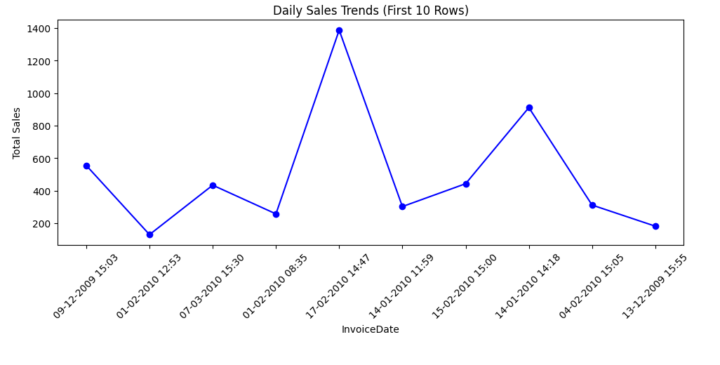
Output:

Slide 8
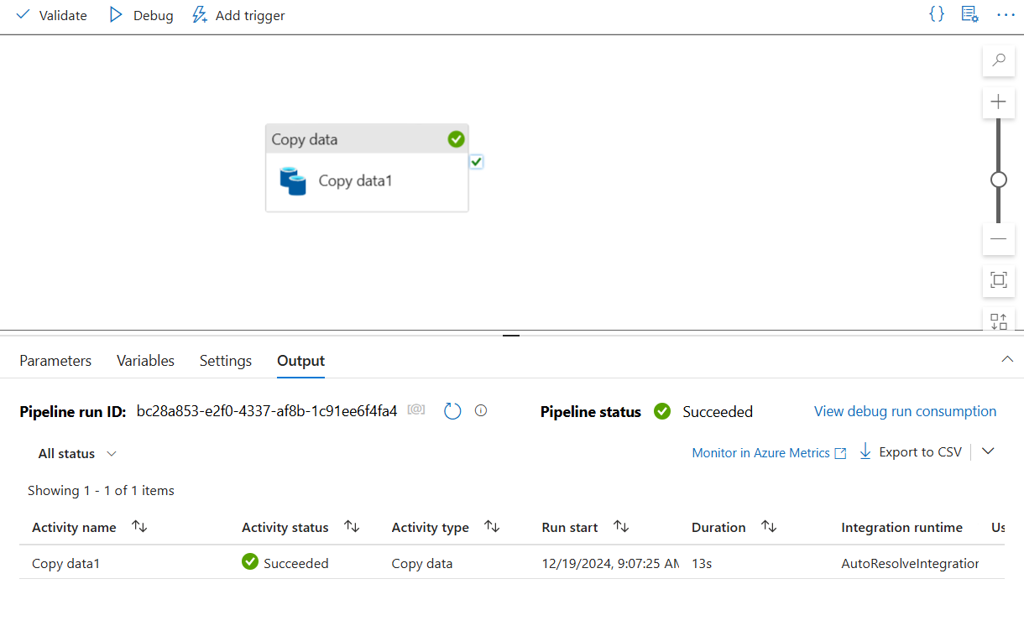
Data Copy Activity in Azure Data Factory:

Slide 9
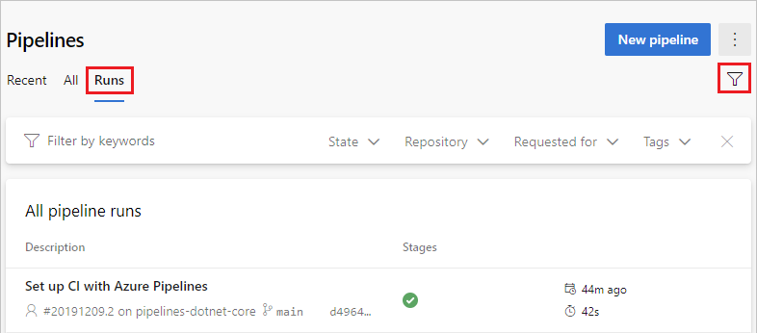
Azure DevOps Pipeline:

Slide 10
Conclusion:
This project showcases a scalable ETL pipeline using Azure services, automating data ingestion with Azure Data Factory and advanced transformations with Azure Databricks. Seamless deployment is ensured through Azure DevOps. It highlights Azure's ability to deliver robust, enterprise-grade data processing solutions.

Slide 11
Thank you
S.Yazhini
Akansha Singh
Harshini V

